Slide 1
MVT: Django follow MVT pattern.
Django
M = Model
V = View
T = Template

Slide 2
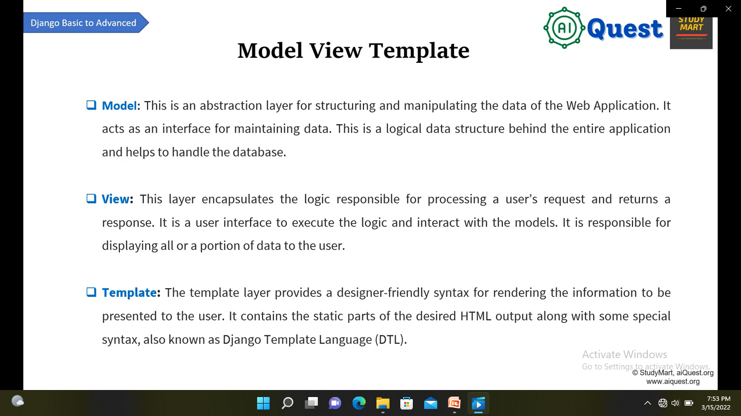
Django

Slide 3
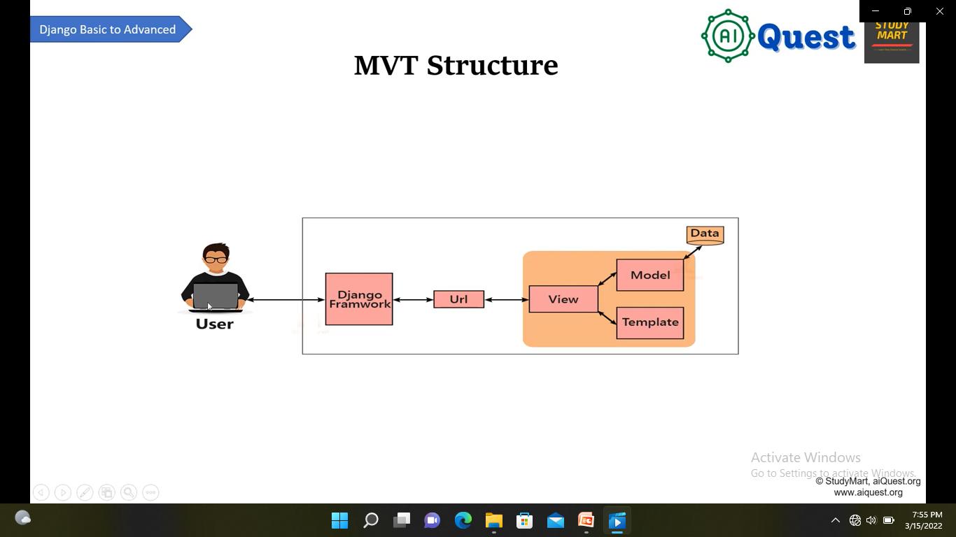
Django
Template means Design

Slide 4
1. Install Django: pip install django For showing which version install in device: django-admin –version Create Project: django-admin startproject projectName -> Enter Run project on browser: python manage.py runserver
Django

Slide 5
Create app : python manage.py startapp AppName Connect apps with main folder: main_folder ->settings.py->installed_APPS-> Apps name *For showing the document: go to the created apps views: from django.http import HttpResponse def function_name(request): return HttpResponse (“……….”) for showing this view in website: go to the main folder urls.py from apps_name import views within urlpattern -> path(“”, views.function_name)
Django

Slide 6
Create virtual Environment:
Django
python –m venv Environment_name
Enter Environment_name folder: cd Environment_name
Enter scripts folder : cd Scripts
For activates: activate.bat
For deactivate : deactivate
We can check Django is installed or not: pip list

Slide 7
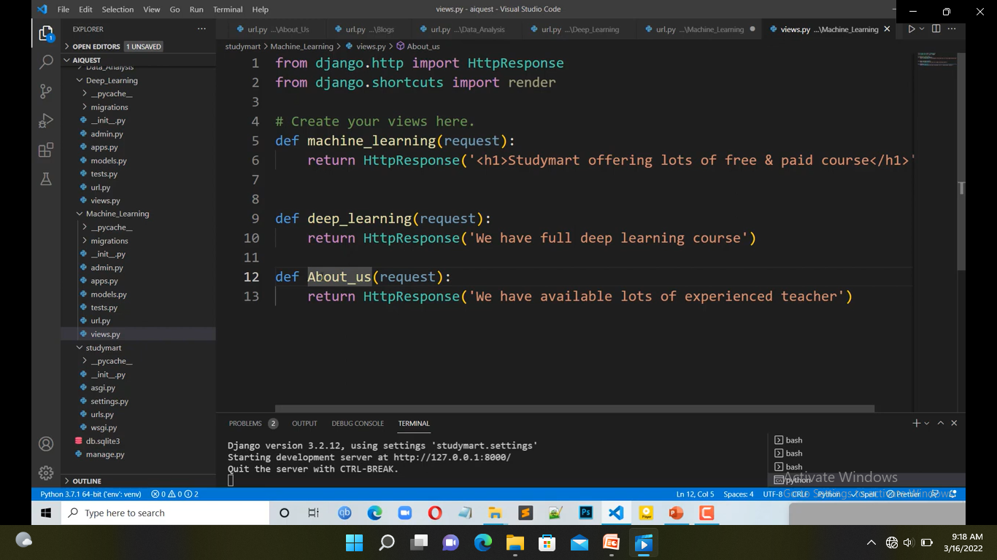
Create url.py for each apps:
Django

Slide 8
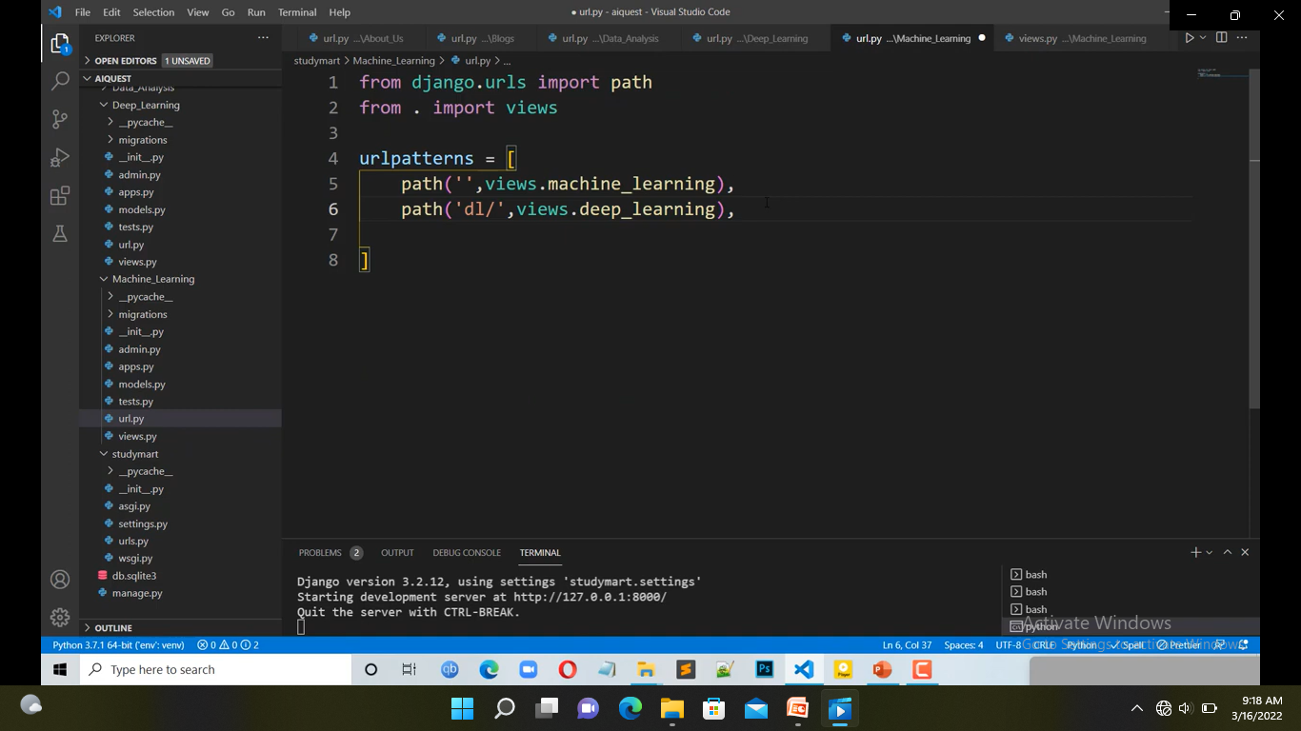
Create url.py for each apps:
Django
. Means you have stayed in current folder
Import views
Function name which remain in views.py

Slide 9
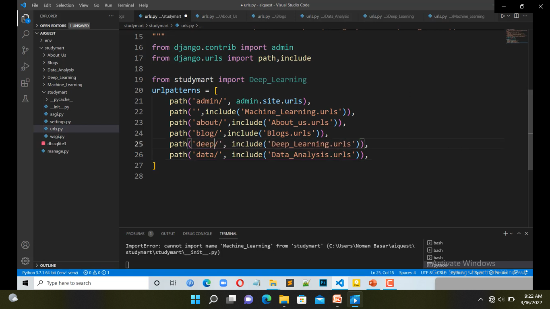
Create url.py for each apps:
Django
Include connect apps urls.py with main urls.py
Apps name. urls file

Slide 10
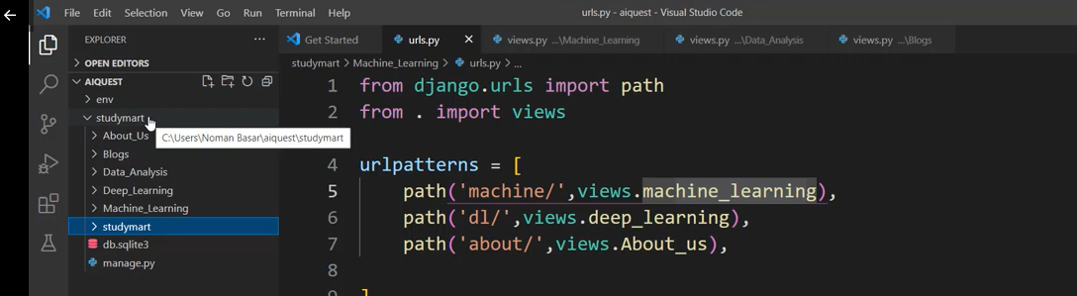
*Create templates folder in outer folder #outer folder ->new_folder->folder_name have to templates ->enter
Django
Template
Outer folder
Inner folder

Slide 11
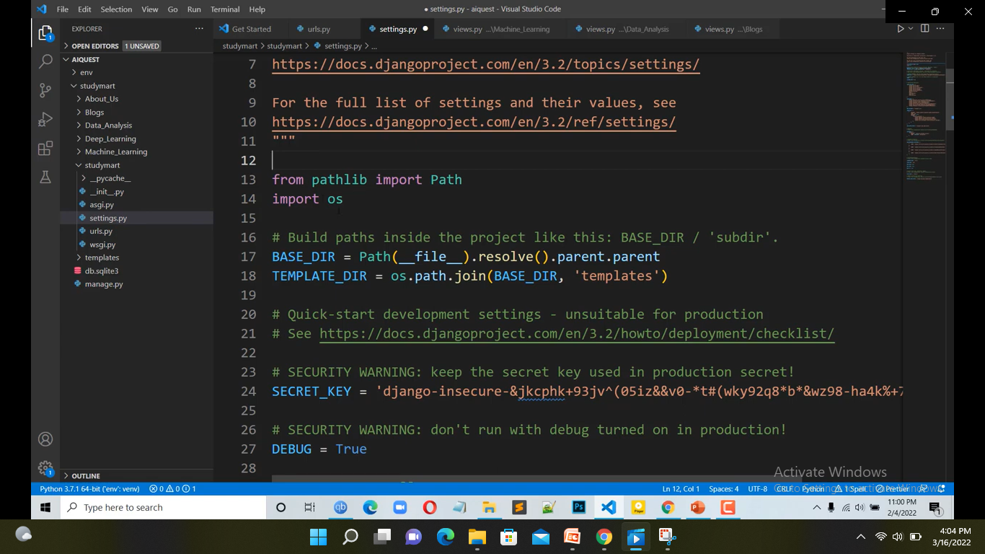
Django
Template
Connect templates Directory in settings.py by a variable ,like: TEMPLATE_DIR

Slide 12
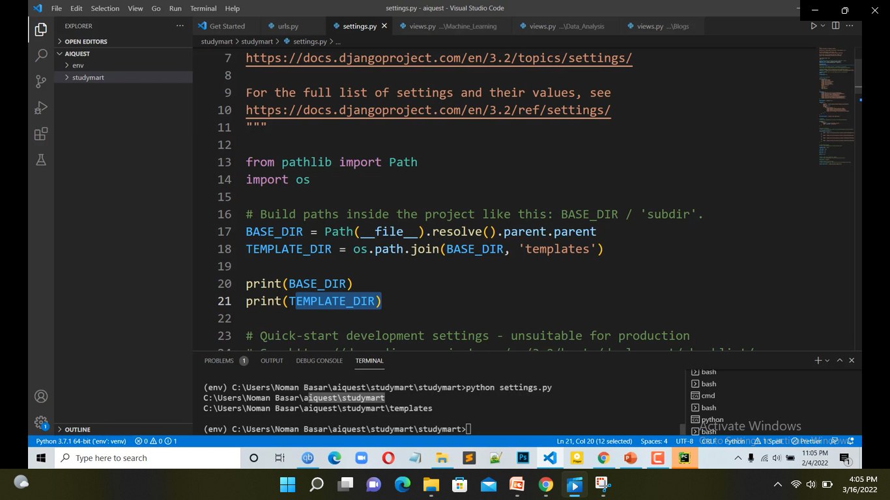
Django
Template
Show the templates directory

Slide 13
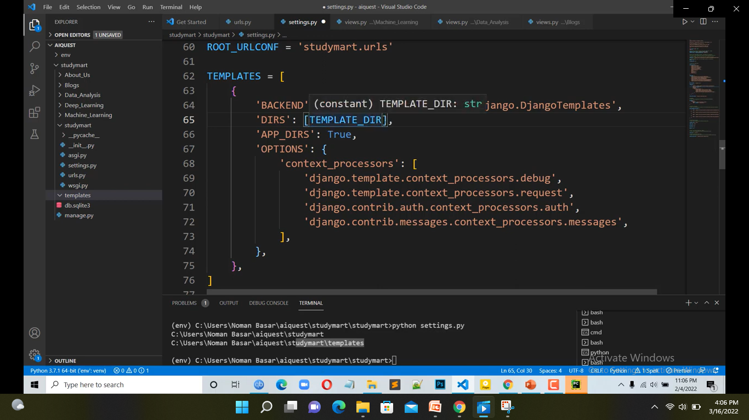
Django
Template
Insert directory variables in ‘DIRS’:[]

Slide 14
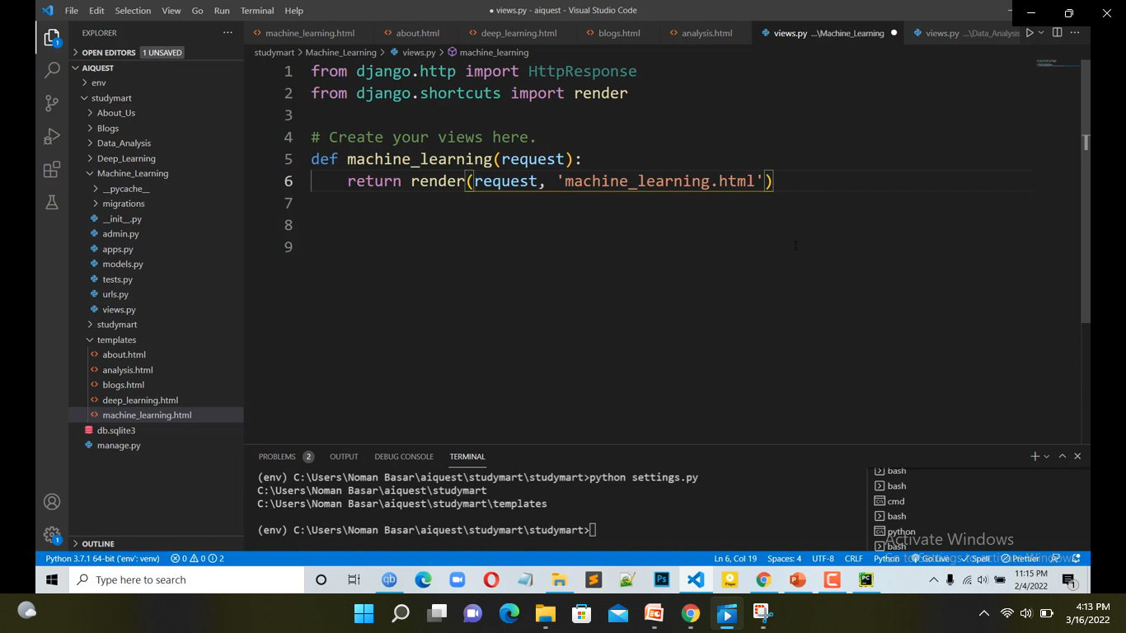
Django
Template
Use ‘render’ instead of HttpResponse for connecting Html file
In render function have to write (request, html file name which has in templates folder), Here Html file name have to same Apps name which only use on this apps view
“render()” pick the value from the html file to view file

Slide 15
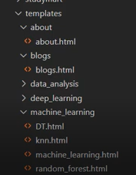
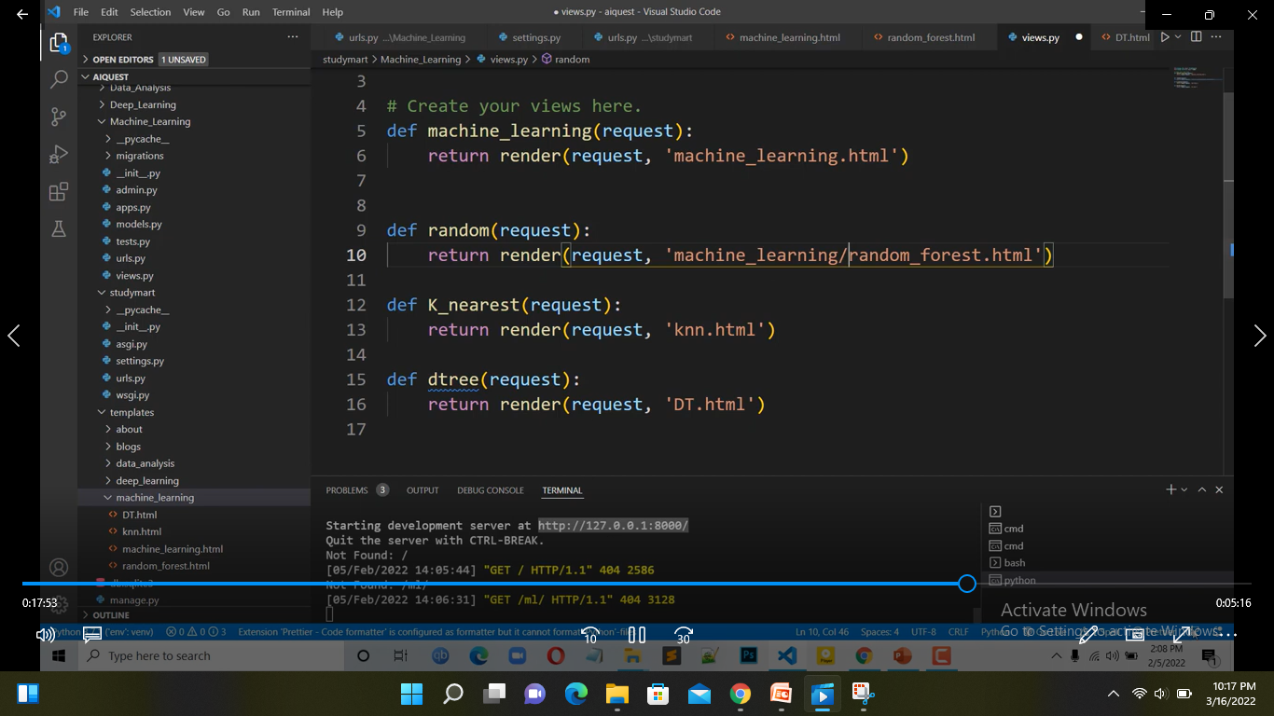
How to Create Folder Inside Template Folder for App:-
Django
Template
Render ,each html file in views on that apps

Slide 16
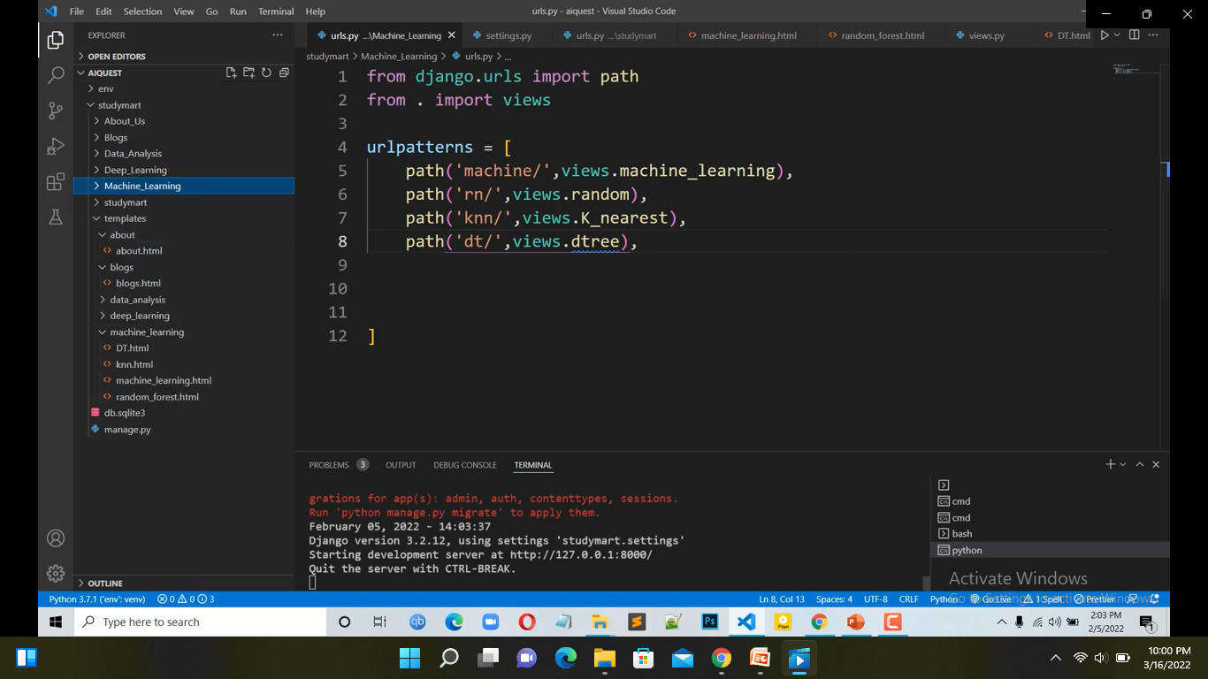
How to Create Folder Inside Template Folder for App:-
Django
Template
Views ,each function
Render each html file in views on that apps

Slide 17
How Django Template Language (DTL) Works with Variable:-
Django
Template
Django Template Language: Django Template uses its own syntax to deal with tags, variables , Expressions etc. A template is render with a context which is used to get value at web page.
Variables:
Variables associated with a context can be accesssed by {{}} (Double curly braces).
*Variables are declared in html file and assigned the value of that variables in view.py file, here, view.py stay in apps which you created. View.py file take a dictionary where the variable remain as a key and it takes value.
This variables value send to the html file by using “context = dictionary name” in render function.

Slide 18
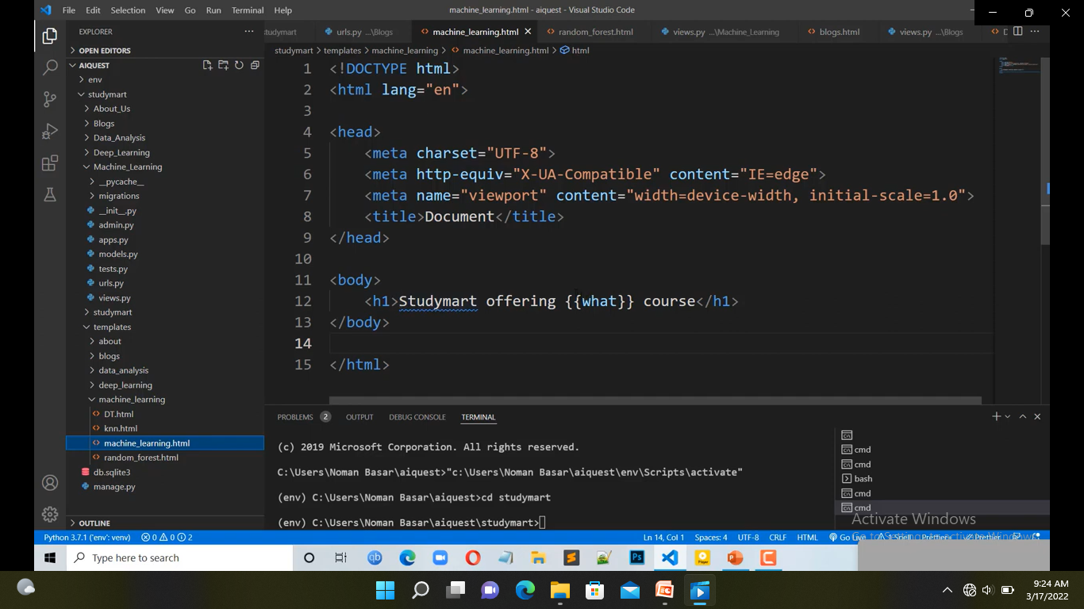
How Django Template Language (DTL) Works with Variable:-
Django
Template
Variables in html file

Slide 19
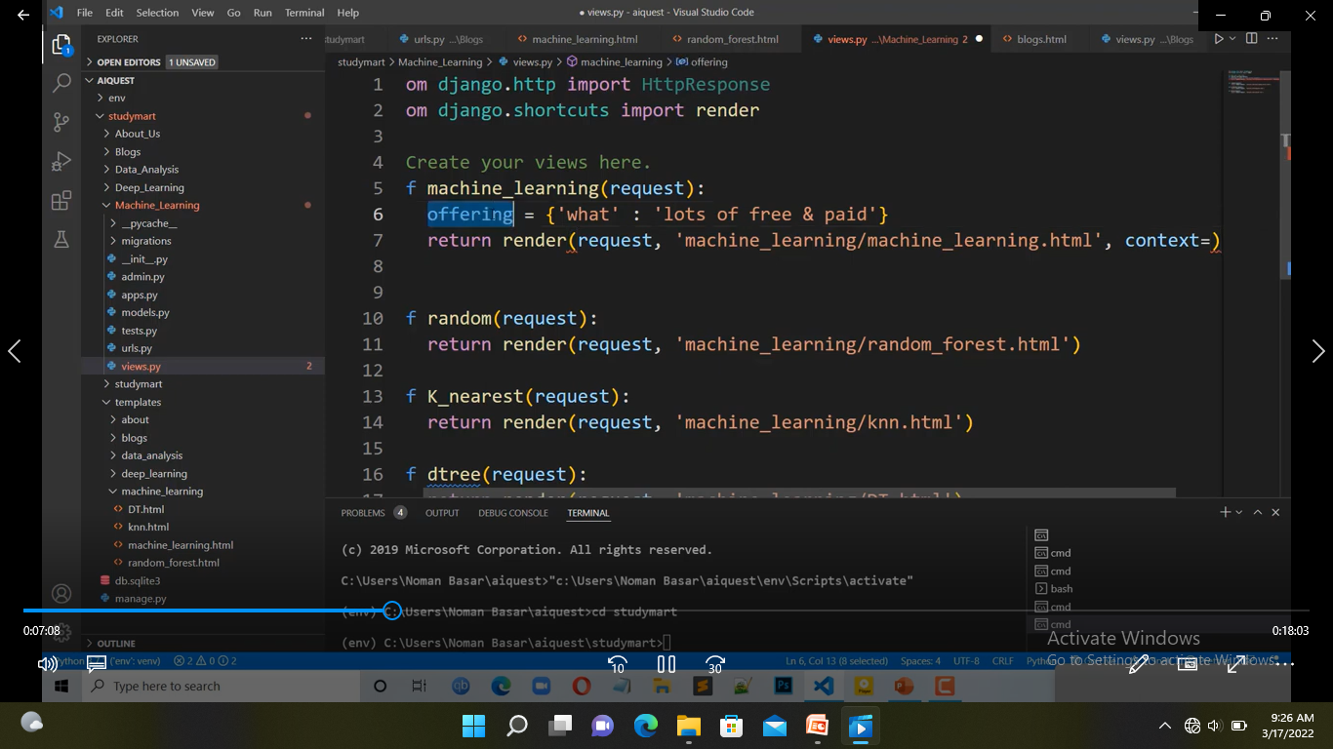
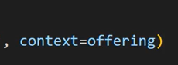
How Django Template Language (DTL) Works with Variable:-
Django
Template
Dictionary
Context = dictionary name

Slide 20
How Django Template Language Work with Filters and Tags :-
Django
Template
Filter:
Filter is used for modifying data. Filter writes on html file.
Syntax of Filter:
{{VARIAVLE | FILTER}}
Tag:
Syntax of tag:
{%Tag%}

Slide 21
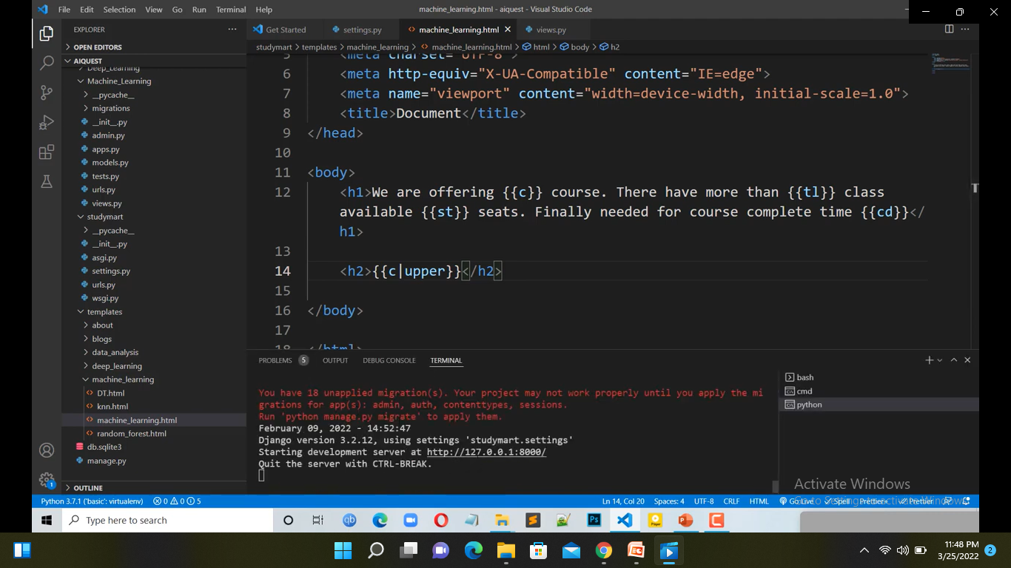
How Django Template Language Work with Filters and Tags :-
Django
Template
Filter:
{{variable | filter}}

Slide 22
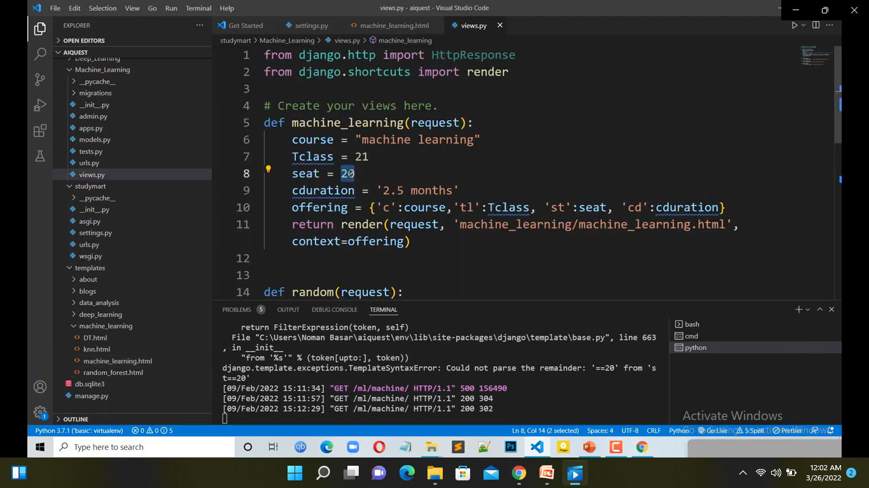
How Django Template Language Work with Filters and Tags :-
Django
Template

Slide 23
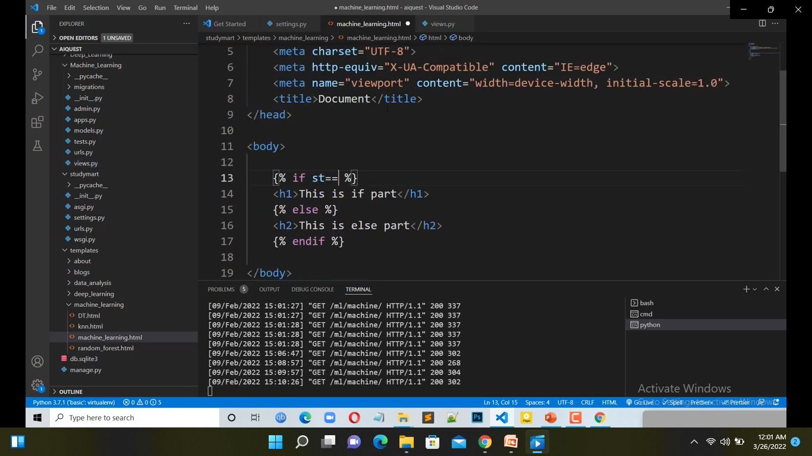
How Django Template Language Work with Filters and Tags :-
Django
Filter & Tags
Start _Tag
End_Tag

Slide 24
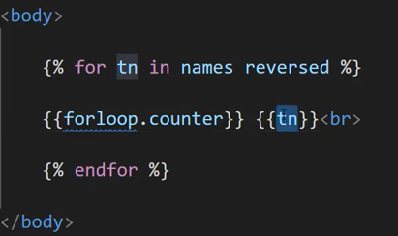
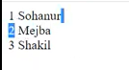
How Django Template Language Work with Filters and Tags :-
Django
Filter & Tags
Count number in names

Slide 25
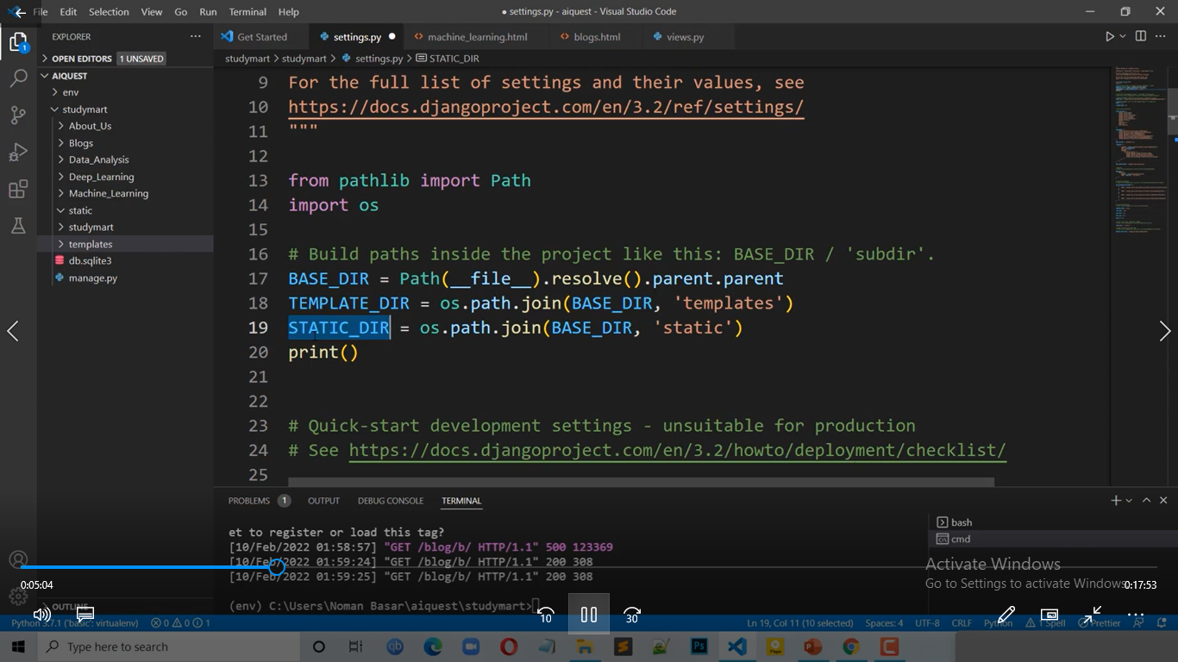
Django Static File:-
Django
Static
* First create Static file : main folder > static folder create > define static file in setting.py
Define Static file path

Slide 26
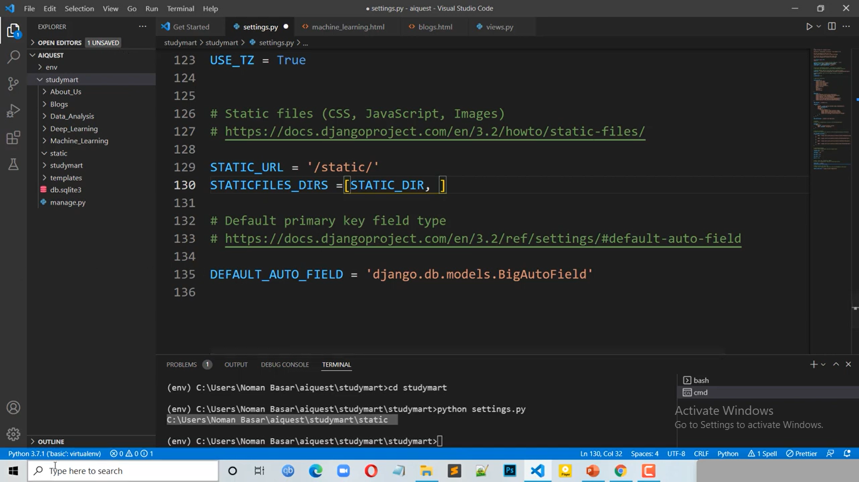
Django Static File:-
Django
Static
Must define here within same variable name.

Slide 27
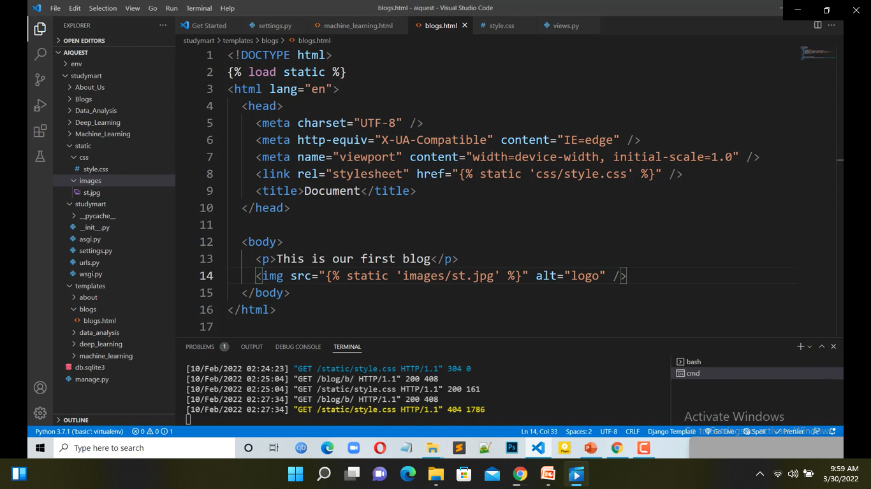
Django Static File:-
Django
Static
Load Static folder
Link the HTML file. Within tag you must be give the main folder then the file location.

Slide 28
Django Static File:-
Django
Static
Load Static folder

